Slide 1

The Linux File System Hierarchy
MODULE 1: GETTING STARTED & NAVIGATING THE SYSTEM

Slide 2
INDEX
Why is "Everything a File" in Linux?
Types of Files in Linux?
How to check File Type.
File System Navigation commands.
Linux File System Hierarchy.
Linux File System Hierarchy Structure.
Basic Linux Commands.

Slide 3
Why is "Everything a File" in Linux?
In Linux, the phrase "everything is a file" means that the operating system represents and accesses almost all system resources—including hardware devices, directories, and processes—through a uniform file-based interface.
The Core Concept: Uniform Interface
Linux treats hardware, processes, and storage as files so programs can interact with the entire system using the exact same basic actions: Open, Read, Write, and Close
Simplicity: Developers only need to learn one consistent set of tools to talk to any resource.

Slide 4
Types of Files in Linux?
In Linux, Everything is treated as File.
All files are divided into 3 types.
Normal or Ordinary files: A normal file can be either text files like (abc.txt, cde.txt) OR binary files like (images, videos etc)
Directory files: These files represent directories. : Windows uses the term folder, while Linux and Unix systems use the term directory, though both describe a container used to organize data.
Device files: In Linux, every device is represented as a file. By using this file we can communicate with that device.

Slide 5
How to check File Type
In Ubuntu, blue color files represents directories and all remaining are considered as normal files. This color conventions are varied from flavor to flavor. It is not standard way to check file type.
We have to use ‘ls –l’ command.
The first character represents the type of file.
  d -> Directory File
  - -> Normal File
  l -> Link File
  c-> Character special File
  b -> Block special File
  s -> Socket File

Slide 6
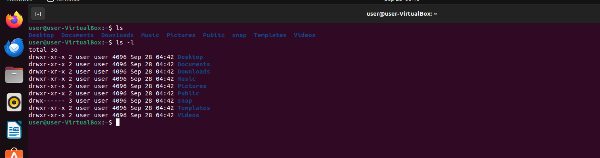
Note : c,b,s are representing system files and mostly used by super user.

Slide 7
File System Navigation Commands
. : represents current directory
.. : represents parent directory
$ cd . : changes to current directory (useless)
$ cd .. : changes to parent directory
$ cd : if we are not passing any argument, then changes to user home directory.
$ cd ~ : changes to user home directory
$ cd –: changes to previous working directory

Slide 8
Linux File System Hierarchy
Directory | Name | Purpose
/ | Root | The absolute base of the file system tree.
/bin | User Binaries | Contains essential command-line binaries (utilities) needed by all users (e.g., ls, cp, mv, rm)
/sbin | System Binaries | Contains crucial executable files used primarily by the system administrator (root) for system maintenance, booting, and administrative tasks.
/boot | Boot Loader | Stores static files required to boot the system.
/dev | Devices | Contains device nodes that represent system hardware (e.g., /dev/sda for a hard drive, /dev/null as a data sink)
/etc | Editable Text Configuration | The hub for host-specific, system-wide configuration files.

Slide 9
Directory | Name | Purpose
/home | Home Directories | Provides personal storage space for individual, non-root users (e.g., /home/username)
/root | Root Home | The dedicated personal home directory explicitly reserved for the administrative superuser (root).
/lib | System Libraries | Contains the essential shared libraries and kernel modules that the operating system needs to boot up and run basic commands.
/media | Removable Media | Serving as an automatic mount point for removable devices like USB drives, external hard disks, or CD-ROMs.
/mnt | Mount | A location reserved for system administrators to manually mount temporary filesystems or network shares.
/opt | Optional | Third-party, proprietary, or standalone applications that are not part of the core operating system and are typically not managed by the default distribution package manager (like apt or dnf).
/proc | Processes | A virtual, in-memory filesystem that tracks real-time kernel information and state values for active processes.
/sys | System | Another virtual filesystem providing specialized interface for hardware devices and drivers.

Slide 10
Directory | Name | Purpose
/run | Runtime Data | Contains system runtime information.
/tmp | Temporary | A public scratchpad for apps to dump volatile temporary files, often completely wiped automatically upon system reboot.
/usr | User System Resources | The largest directory segment; contains user applications, secondary binaries (/usr/bin), documentation, and source code.
/var | Variable Data | Stores dynamic, frequently changing files such as system logs (/var/log), print queues, and web caches.

Slide 11
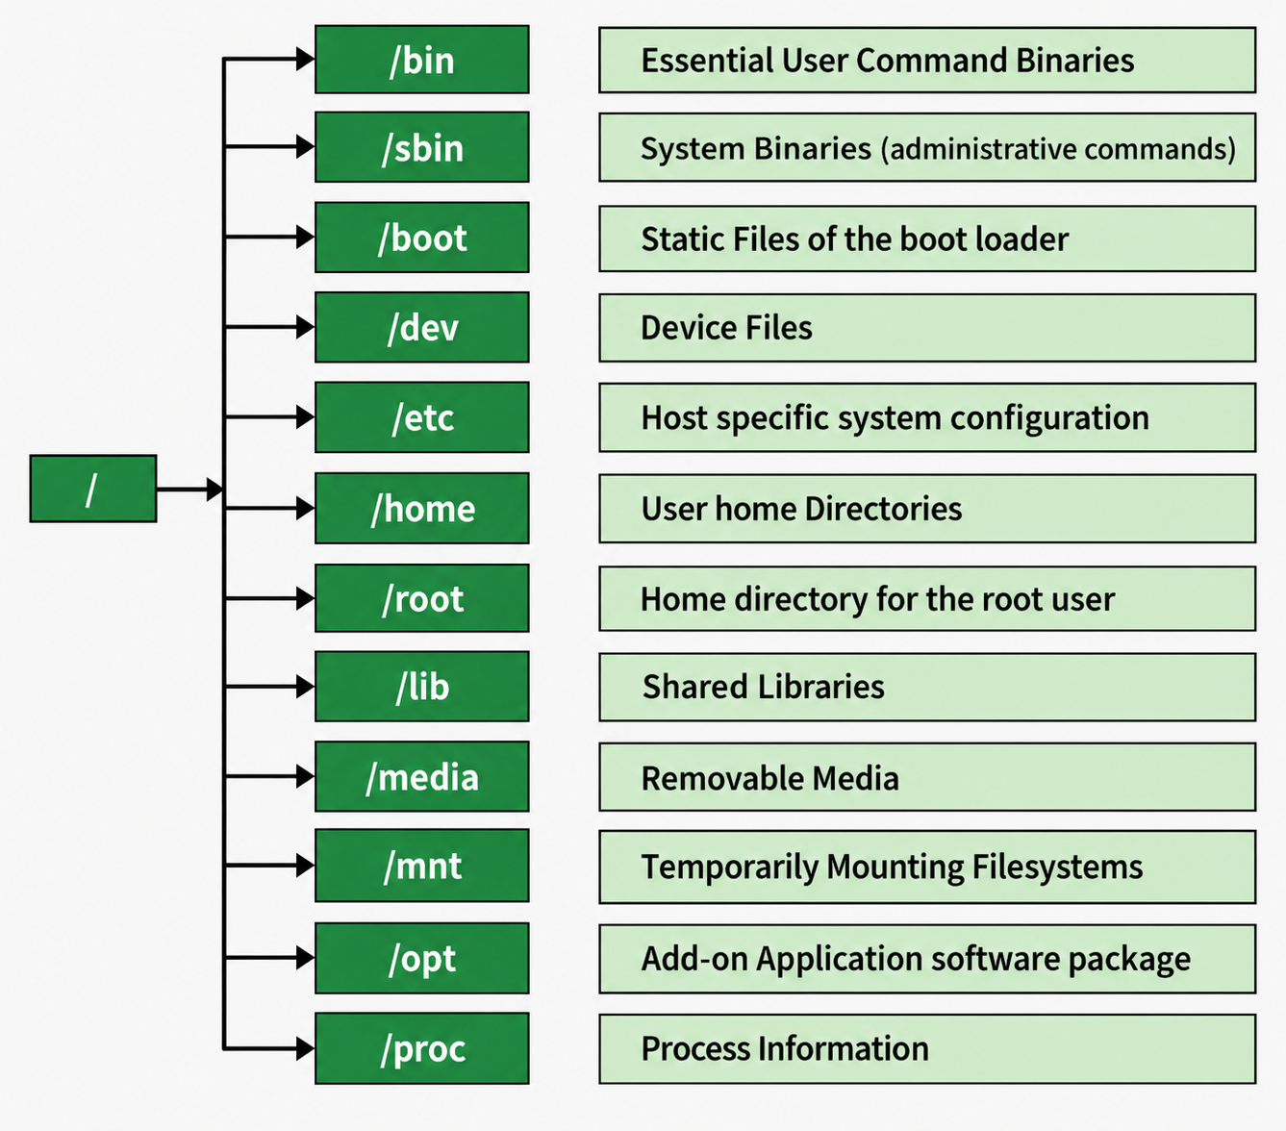
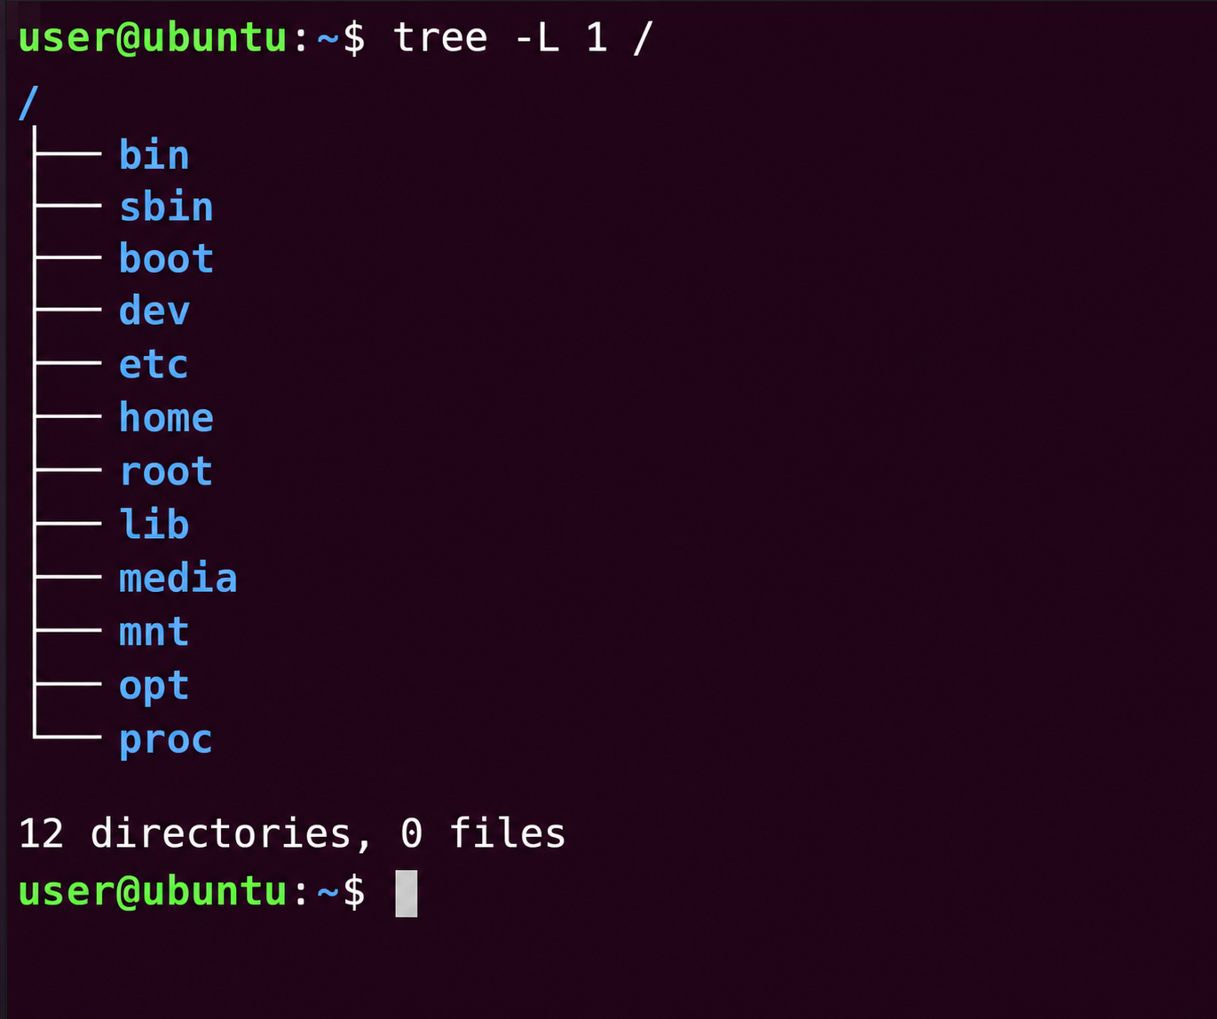
Linux File Hierarchy Structure

Slide 12
Basic Linux Commands
Linux commands are the primary way to interact with a Linux operating system through the terminal.
Linux commands are organized by purpose:
  Navigation & Directory Management
  File Operations
  Searching & Text Processing
  Permissions & System Basics
Learning basic Linux commands helps beginners understand how Linux works and use it efficiently for daily tasks.

Slide 13
Navigation & Directory Management
These commands help you move around the system and organize your folders:
    pwd – print working directory
    ls – lists all files and folders in your current directory
    ls –l – for detailed information
    ls –a – to view hidden files
    mkdir – creates a brand-new directory
    rmdir – removes an empty directory

Slide 14
File Operations
Use these commands to create, view, copy, and delete files.
  touch – creates a blank, empty file.
  cat – concatenates and displays the full contents of a file in the terminal
  head – Views very beginning of a long file.
  tail – Views the end of a long file.
  cp – copies files or directories from one place to another.
  mv – moves or renames files and folders.
  rm – deletes files permanently.
  rm –r – to delete a folder and everything inside it.

Slide 15
Searching & Text Processing
These commands let you look through text or find specific data quickly
  grep – Searches for specific words or patterns within text or files.
  find - Searches for files and directories across your entire system layout based on filters like name or date.
  clear - Clears the terminal screen to give you a clean slate

Slide 16
Permissions & System Basics
Essential commands for managing permissions and seeing how the system is performing:
  sudo – Executes a command with administrative (root) privileges.
  chmod – Changes the file read, write, and execute permissions.
  df –h - Shows how much available disk space you have in a human-readable format.
  top or htop – Displays running processes and system resources in real-time.

